Slide 1
Introduction to Turtlebot3: Step-by-step instruction
ECE 4881/588 Shiwen Liao

Slide 2
Setup Remote PC (Workstation)
Linux
Install Ubuntu
Install ROS
Install dependent packages for Turtlebot 3
Windows
Install Putty
Install Xming
Install Robotics Operation System Toolbox on Matlab

Slide 3
Create a Bootable USB Flash Drive
First we need to create a bootable USB flash drive which contains a Ubuntu system image.
Make sure UBS flash drive has at least 16 GB capacity and data is safely backed up.
Download Ubuntu image;
Win32 Disk Imager;
Select right USB flash drive;
Load image file of Ubuntu;
Write image file to flash drive.

Slide 4
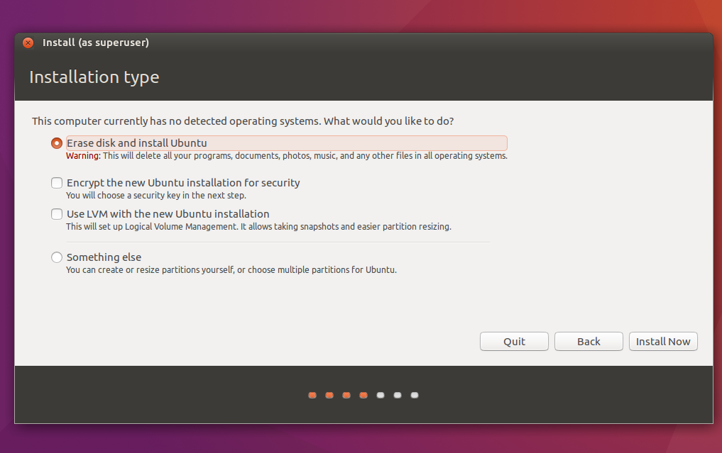
Installation Type

Slide 5
Install Ubuntu
Plug in the booting USB ash drive, restart your PC and keep pressing [F2], [DEL] or whatever the specified BIOS access key is.
At the BIOS setting screen, choose the USB flash drive as the booting device, save then leave BIOS setting.
Installation will automatically start, follow the onscreen instruction until it ask for Installation type.
Select something else at Installation type, and manually select the hard drive partition where Ubuntu to be installed.
Follow the onscreen instruction till the end and unplug USB drive before it restart.

Slide 6
Install ROS
Setup sources list
sudo sh -c 'echo "deb http://packages.ros.org/ros/ubuntu $(lsb_release -sc) main" > /etc/apt/sources.list.d/ros-latest.list'
Setup keys
sudo apt-key adv --keyserver hkp://ha.pool.sks-keyservers.net:80 --recv-key 421C365BD9FF1F717815A3895523BAEEB01FA116
Installation
sudo apt-get update
sudo apt-get install ros-kinetic-desktop-full
Initialize rosdep
sudo rosdep init
rosdep update
Environment setupt
echo "source /opt/ros/kinetic/setup.bash" >> ~/.bashrc
source ~/.bashrc

Slide 7
Install catkin tools
We use Catkin Command Line Tools to build packages
For the first time use, we need a little more settings
Source the environment:
source /opt/ros/kinetic/setup.bash
Create workspace:
mkdir -p ~/catkin_ws/src
cd ~/catkin_ws/src
c a t k i n i n i t wo r k s p a c e
Build the workspace:
cd ~/catkin_ws/
catkin build
Source your workspace:
Source devel/setup.bash

Slide 8
Install Turtlebot 3 Dependent Packages
We need some dependent packages for Turtlebot 3 control

Slide 9
Software Setup on Turtlebot 3
Install Ubuntu Mate
Install ROS
Install dependent packages for Turtlebot 3
ROS node package for PI camera
ROS node package for LDS

Slide 10
Network Configuration Between WS and TB3
On Turtlebot 3
idle ~/.bashrc
export ROS_MASTER_URL=http://localhost:11311
export ROS_HOSTNAME=IP_OF_TB3
export ROS_IP=IP_OF_TB3
echo "ROS_MASTER_URI: "$ROS_MASTER_URI
echo "ROS_HOSTNAME: "$ROS_HOSTNAME
echo "ROS_IP: "$ROS_IP
On Workstation
gedit ~/.bashrc
export ROS_MASTER_URL=http://IP_OF_TB3:11311
export ROS_HOSTNAME=IP_OF_WS
export ROS_IP=IP_OF_WS
echo "ROS_MASTER_URI: "$ROS_MASTER_URI
echo "ROS_HOSTNAME: "$ROS_HOSTNAME
echo "ROS_IP: "$ROS_IP

Slide 11
Gazebo Simulation
Install dependent packages for TurtleBot3 Simulation
cd ~/catkin_ws/src/
git clone https://github.com/ROBOTIS-GIT/turtlebot3_simulations.git
cd ~/catkin_ws
Catkin build
Since our robot is Turtlebot 3 burger, execute command below will reduce some typing work.
Echo “export TURTLEBOT3_MODEL=burger” >> ~/.bashrc
Play with simulator
roslaunch turtlebot3_gazebo turtlebot3_world.launch
roslaunch turtlebot3_gazebo turtlebot3_gazebo_rviz.launch

Slide 12
Bringup Turtlebot 3
After software installations on both robot and workstation, and proper network configuration between them, we can now play with Turtlebot 3 buger.
First, start a ROS master node before you run any other ROS applications.
roscore
Bring up basic packages to start TurtleBot3 applications.
roslaunch turtlebot3_bringup turtlebot3_robot.launch
Run Rviz to visualize robot and sensor data
roslaunch turtlebot3_bringup turtlebot3_remote.launch
rosrun rviz rviz -d `rospack find turtlebot3_description`/rviz/model.rviz
Notes:
Bringup and teleop

Slide 13
Applications
Obstacle detection
rosrun turtlebot3_example turtlebot3_obstacle.py
Turtlebot Follower
This is a good example, you can look into the code and play with it. Get yourself familiar with ROS and Turtlebot 3.
Start a ROS master by roscore
Bringup Turtlebot
Run Rviz on workstation to visualize your robot
Launch Turtlebot Follower Demo
cd ~/catkin_ws/src/turtlebot3_applications/turtlebot3_follower/src
roslaunch turtlebot3_follow_filter turtlebot3_follow_filter.launch
rosrun turtlebot3_follower follower.py

Slide 14
Play Turtlebot with Matlab
Bringup Turtlebot
Connect Matlab to ROS master as a ROS node
Subscribe to sensors’ data (lidar and camera)
Visualize and process data
Send command to robot and drive it.

Slide 15
Launch Turtlebot
Launch robot (mobile base): roslaunch turtlebot3_bringup turtlebot3_robot.launch
Launch Pi camera: roslaunch turtlebot3_bringup turtlebot3_rpicamera.launch
Launch LiDar: roslaunch hls_lfcd_lds_driver hlds_laser.launch
Shut Down Robot: sudo shutdown
Login ID: tb3-ece
Password: 488588

Slide 16
Software Packages
Matlab & ROS toolbox: http://caenfaq.engin.umich.edu/software-for-students/matlab-for-students
Putty & Xming: Configure PuTTY and Enable X11 Forwarding, see these instructions (http://www.geo.mtu.edu/geoschem/docs/putty_install.html)

Slide 17
Office hours: Wednesday 3:00pm – 5:00pm
Office: 98 FCN (Fairlane Center North)
Email: lshiwen@umich.edu

